Slide 1

Revolutionizing Delivery: A Dual-Drone Approach
Created by
Your Name

Slide 2
Problem & Opportunity
Growing Demand
Challenges
Innovation Need and Requirement analysis
* On-demand delivery (UberEats, Amazon) experiencing explosive growth.
* Consumers crave faster delivery times and increased convenience.
* Traffic congestion hindering delivery speeds in urban areas.
* Traditional delivery methods struggle to meet rising demand efficiently.
* Environmental concerns surrounding delivery vehicle emissions.
* Disruptive solutions needed to streamline delivery processes.
* Technologies like drones offer the potential for faster, more sustainable delivery.
* User needs and expectations for delivery speed and convenience.
* Delivery platform (UberEats, Amazon) integration requirements.
* Regulatory landscape for commercial drone operation.

Slide 3
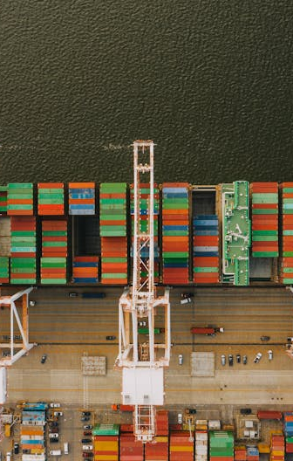
Introducing the Solution
Addressing Challenges
Dual-Drone Delivery
Our innovative drone delivery system tackles the limitations of traditional methods.
By leveraging drone technology, we aim to:
Reduce traffic congestion with aerial delivery routes.
Increase delivery speed for faster service, especially in urban areas.
Minimize environmental impact with potentially cleaner energy sources for drones.
* We propose a unique system with two distinct drone models catering to specific customer segments:
* Swift: Designed for speed and maneuverability, ideal for fast urban deliveries (e.g., food orders).
* Hauler: Built with larger capacity and range, perfect for delivering bulkier items in suburban areas.

Slide 4
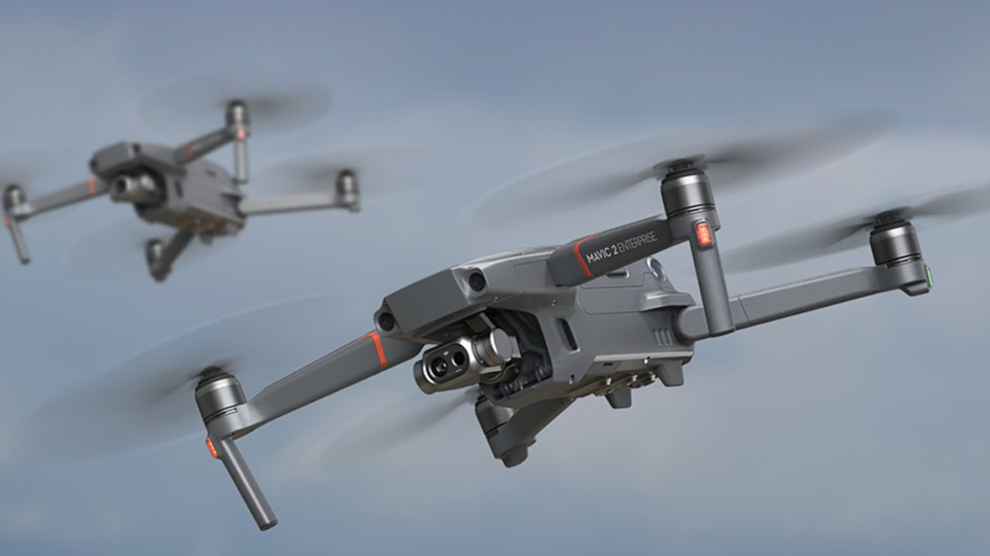
Design Analysis
Our team will conduct a comprehensive design analysis to ensure:
Functionality: Drones meet payload, range, and navigation requirements.
Usability: Intuitive controls for safe and efficient operation.
Reliability: Robust design for safe and consistent performance.
Manufacturability: Cost-effective and scalable production methods.
Sustainability: Use of eco-friendly materials and energy sources where possible.
Maintainability: Easy access for repairs and maintenance.

Slide 5
Market Segmentation
Targeted Audience
Customer Segments
Showcases the relevance of the dual-drone approach
Young Professionals (22-40) in Urban Areas
Suburban Families (30-55)
young urban professionals and suburban families for the success of the dual-drone delivery system.
Young Professionals(22-40):
Busy urban dwellers who value convenience and speed.
Often order prepared meals through on-demand delivery platforms like UberEats.
Prioritize fast delivery times to fit their hectic lifestyles. (Add to pie chart)
Suburban Families (30-55):
Juggle work, family, and household needs.
Utilize online retail platforms like Amazon for various purchases.
Benefit from convenient delivery of bulkier items directly to their homes. (Add to pie chart)

Slide 6
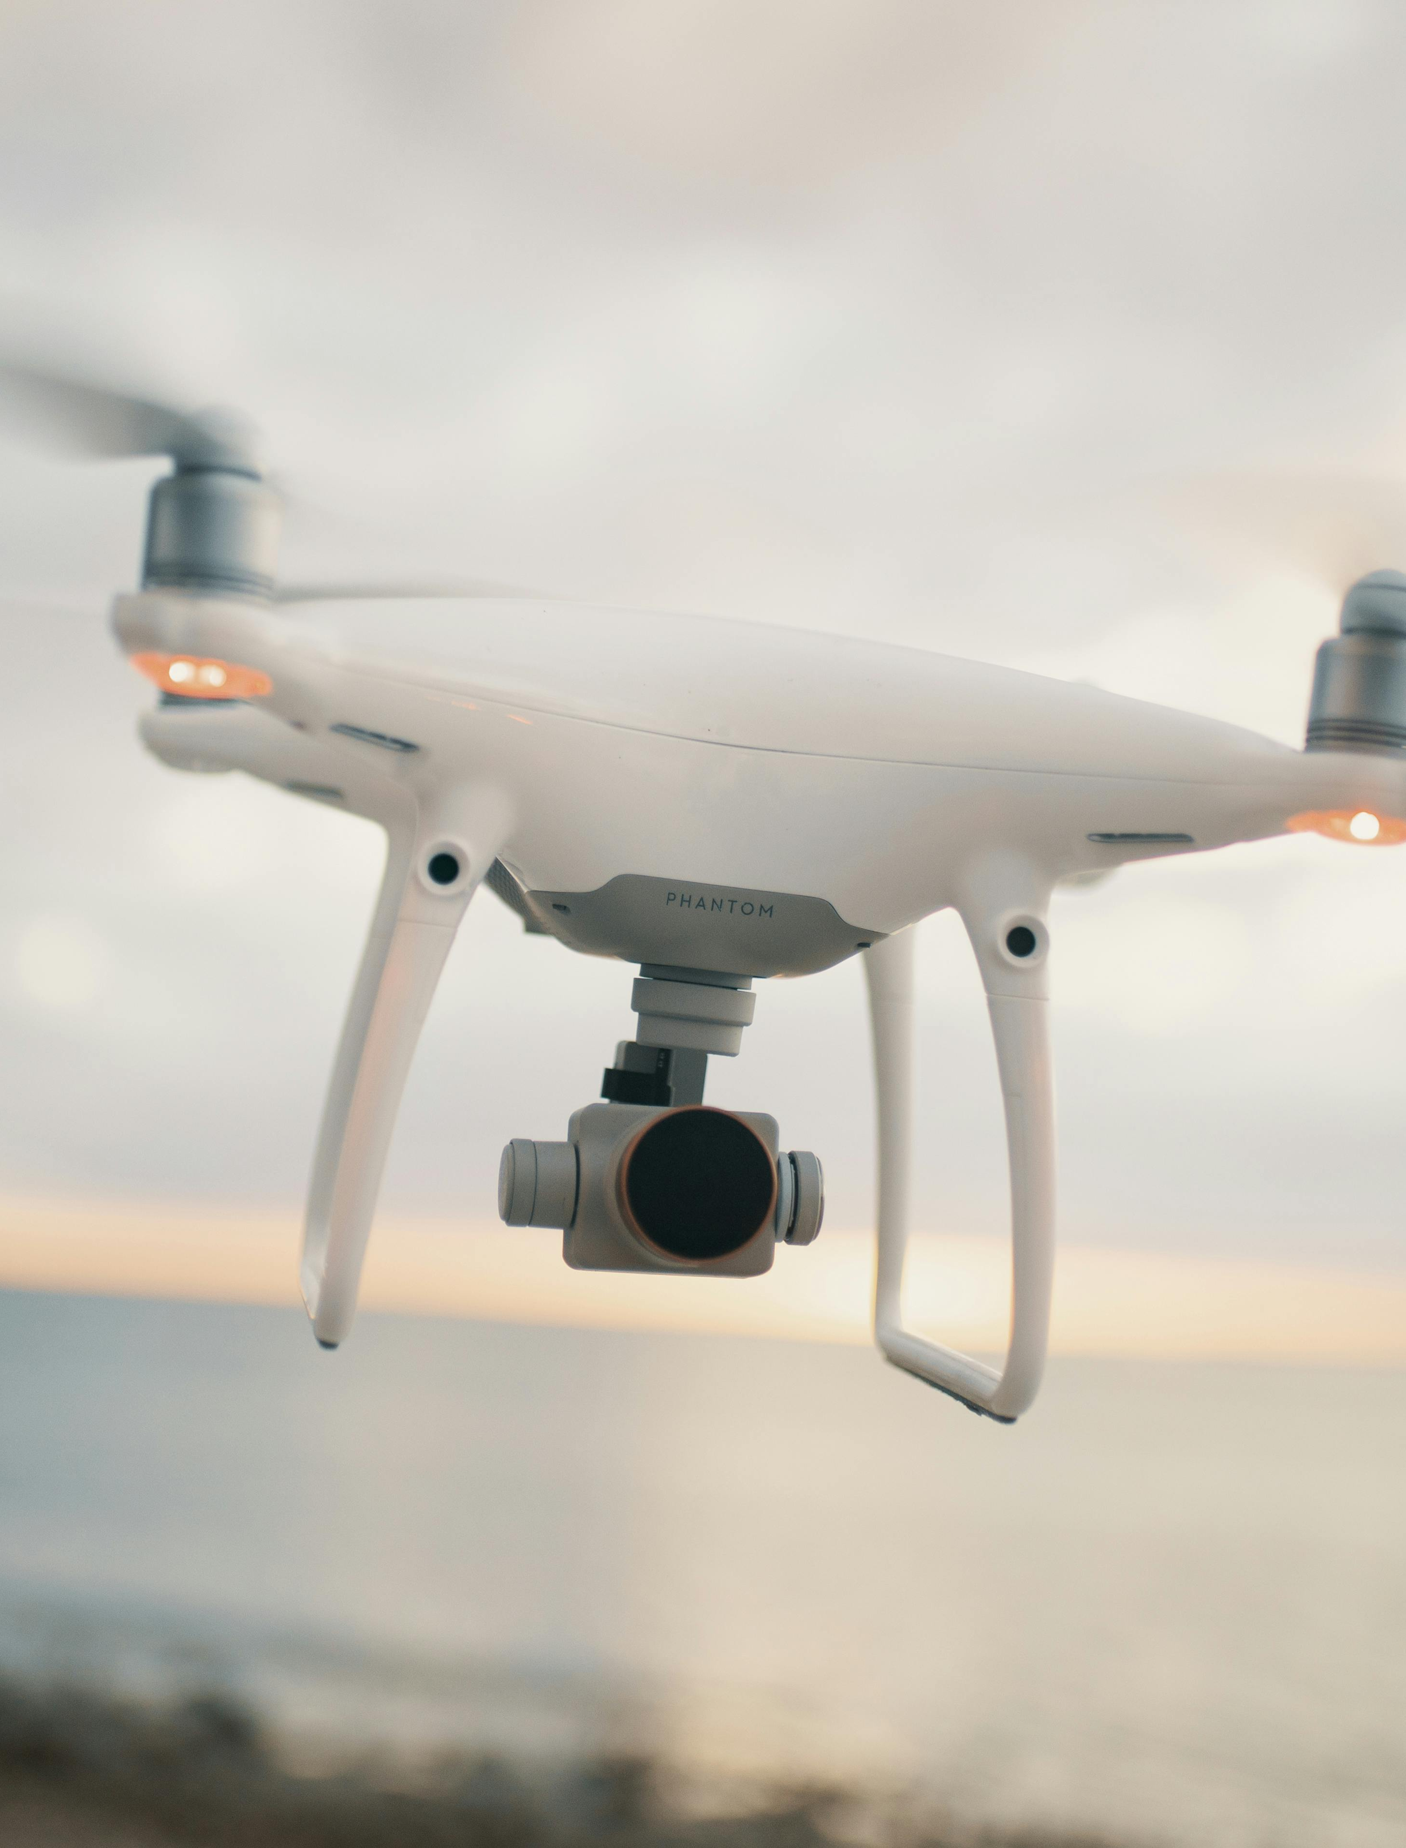
Drone Model 1: Swift
Swift - Urban Delivery
Urban Benefits
Payload: Optimized for prepared meals and smaller packages (think takeout orders, grocery staples).
Range: Designed for shorter distances (5-10 km) ideal for dense urban environments.
Navigation: Equipped with advanced autonomous navigation features for safe and efficient flight paths
Faster Deliveries: Swift's compact design and maneuverability enable quick navigation through cityscapes, reducing delivery times for time-pressed customers.
Reduced Traffic Congestion: By taking deliveries off the road, Swift contributes to alleviating urban traffic congestion, benefiting all city residents.
Design consideration:
Compact & Quiet:
Safety Firstseamless Integration:

Slide 7
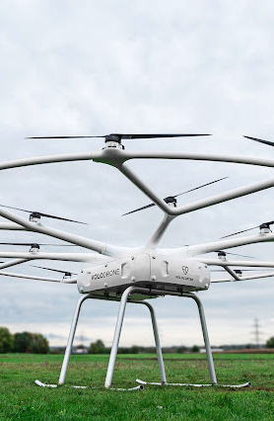
Drone Model 2: Hauler
Suburban Benefits
Hauler - Suburban Delivery
Functionality Breakdown:
Payload: Designed for handling bulkier items with a higher weight capacity compared to Swift.
Range: Extends the delivery range (10-20 km) to cover suburban areas effectively.
Navigation: Equipped with advanced autonomous navigation features for safe and efficient flight paths over longer distances.
Design Considerations:
Larger Capacity
Stable Flight
Weather Resistance
Bulkier Items: Hauler's larger capacity allows convenient delivery of household goods, groceries, and other larger packages directly to suburban homes.
Reduced Car Trips: By eliminating the need for frequent trips to stores, Hauler helps reduce car use in suburbs, contributing to a more sustainable lifestyle.
Photos provided by Pexels
This Photo by Unknown Author is licensed under CC BY-SA-NC

Slide 8

Project Plan Timeline
Timeline Overview and Key Milestones
Prototype Development (Months 1):
* Functional prototypes with key features (payload, range, navigation)
* Delivery platform integration (UberEats, Amazon)
Testing & Refinement (Month 2-3):
* Rigorous safety testing
* Real-world pilot programs with user feedback loop
* Design and functionality refinement based on user feedback
Regulatory Approval & Manufacturing (Months 3-4):
* Secure FAA approvals for commercial operation
* Develop mass production plan
* Secure manufacturing partnerships
Market Launch & Expansion (Months 4):
* Initial rollout in high-demand areas
* Partnerships with major delivery platforms and retailers
* Targeted marketing campaigns

Slide 9
Risk Assessment & Decision-Making
Risk Assessment:
Mitigation Strategies:
Decision-Making:
Technical Challenges: Difficulties in achieving desired drone performance (range, payload capacity).
Regulatory Hurdles: Delays in obtaining FAA approvals for commercial drone operation.
Public Perception: Concerns about safety, privacy, or noise pollution related to drone delivery.
Technical Challenges - Collaborate with experienced drone engineers and conduct thorough testing. * Regulatory Hurdles - Proactively engage with the FAA and stay updated on regulations. * Public Perception - Implement robust safety measures, conduct public awareness campaigns, and emphasize environmental benefits.
Trade-off Analysis: Weighing different design options against factors like cost, performance, and manufacturability.
Example: Prioritize maneuverability (higher cost) for Swift in dense urban environments.
Economic Analysis: Evaluating investment costs, potential returns on investment, and overall market viability.

Slide 10
Conclusion & Call to Action
Recap:
Call to Action:
Growing Delivery Demand & Challenges
Dual-Drone Delivery System (Swift & Hauler)
Comprehensive Design Analysis
Clear Project Timeline & Milestones
Proactive Risk Assessment & Decision-Making
Strong Statement: Craft a powerful call to action that compels the audience to consider your proposal. Here are a few options:
"Let's discuss how drone delivery can revolutionize your business and meet the growing demand for faster, more convenient deliveries."
"Partner with us to shape the future of sustainable and efficient on-demand delivery."
"Join us in creating a world where the sky's the limit for convenient and environmentally responsible deliveries."

Slide 11
References
Market Research & Segmentation:
Yieldify - Market Segmentation: Audience Segmentation Software – Yieldify
Morder Intelligence : Drone Delivery Market Size, Analysis & Statistics (mordorintelligence.com)
Mckinsey : How will same-day and on-demand delivery evolve in urban markets? | McKinsey
Simiarwebblog: 8 Types of Market Segmentation: Explained & Explored | Similarweb
Drone Delivery Industry:
Amazon - Drone Delivery System: How Amazon is building its drone delivery system (aboutamazon.com)
YouTube - Top Food Delivery Drones : Bing Videos
Project Management & Design:
Project Management Institute (PMI): link 3: Project Management Institute | PMI
Drone Design Resources:
Tryenginering : Designing Drones - TryEngineering.org Powered by IEEE

